Slide 1
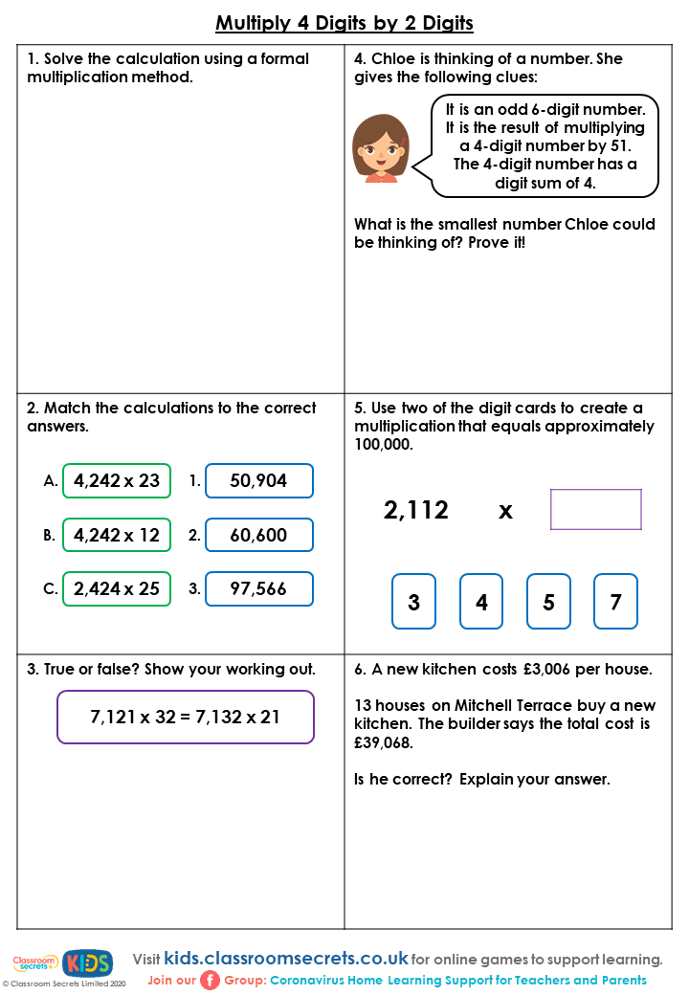
 |  | 3 | 8 | 0 | 2
x |  |  |  | 2 | 3

