Slide 1
Y4
MATHS
Represent Numbers to 1,000

Slide 2
Represent Numbers to 1,000
Key Information
A representation is a picture that shows a number or calculation. For example, this could be a bar model or a place value chart with counters.
Base 10 equipment refers to a physical resource which represents numbers. The small cubes represent ‘ones’; the rods represent ‘tens’ and are made up of 10 small cubes; the squares represent ‘hundreds’ and are made up of 10 rods; the large cubes represent ‘thousands’ and are made up of 10 squares.
Place value counters refer to a physical resource which represent numbers. They are usually in different colours and have different numbers written on them to represent ‘ones’, ‘tens’, ‘hundreds’ etc. They can also represent decimal numbers.

Slide 3
Represent Numbers to 1,000
Let’s start with a question about representing numbers to 100, which is linked to the new learning later in this lesson.

Slide 4
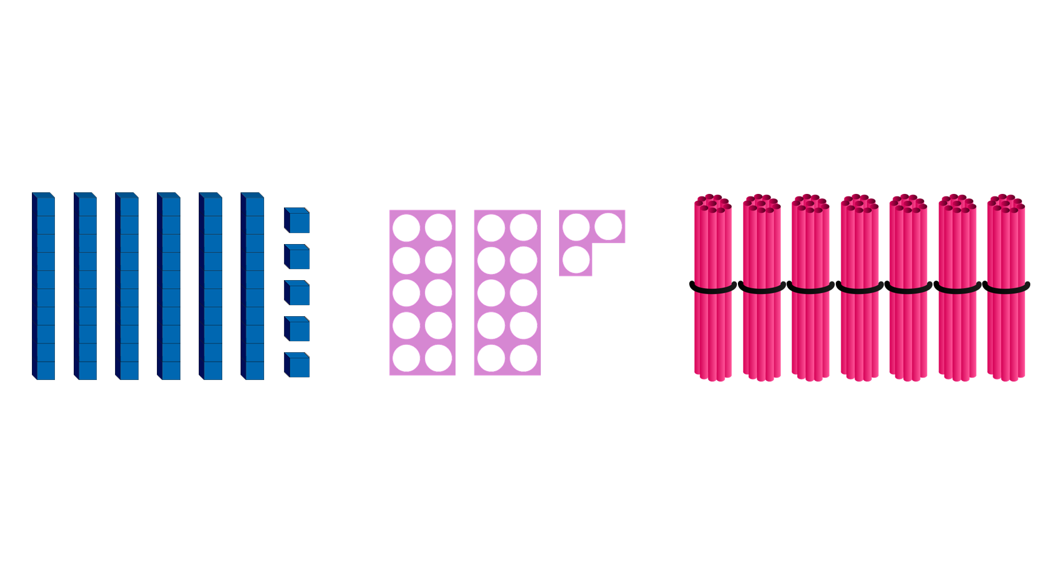
Represent Numbers to 1,000
Look at the representations below. Identify the value shown by each representation.

Slide 5
Represent Numbers to 1,000
Look at the representations below. Identify the value shown by each representation.
65
23
70

Slide 6
Represent Numbers to 1,000
Now that we are ready to move on, we can learn about representing numbers to 1,000.

Slide 7
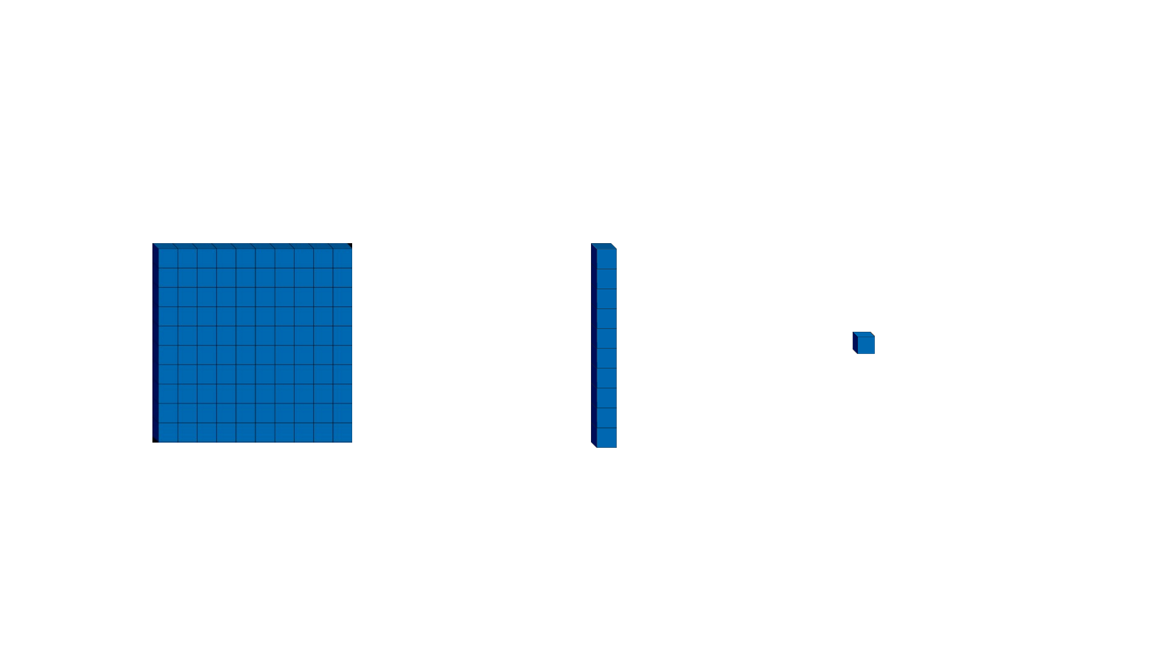
Represent Numbers to 1,000
We can represent numbers in different ways with Base 10 or place value counters. To represent values correctly, we must remember what each representation is worth.
= 100
= 10
= 1
100
10
1

Slide 8
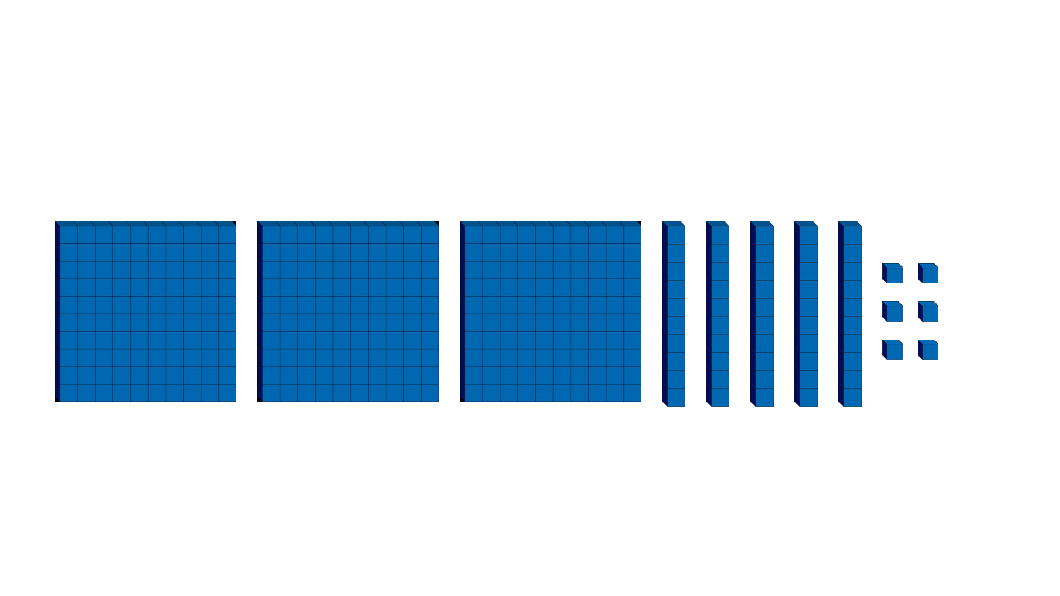
Represent Numbers to 1,000
When representing numbers using representations, it is often easiest to start counting from the biggest value.
Follow up question
What number is shown by the Base 10?

Slide 9
Represent Numbers to 1,000
There are 3 hundreds, 5 tens and 6 ones.
356 is shown by the Base 10.

Slide 10
Represent Numbers to 1,000
We represent numbers using place value counters in the same way.
Start by counting the 100s, 10s then 1s.
100
100
10
10
10
10
10
10
10
10
10
1
1
1
1
1
1
1
Follow up question
What number is shown by the place value counters?

Slide 11
Represent Numbers to 1,000
297
100
100
10
10
10
10
10
10
10
10
10
1
1
1
1
1
1
1

Slide 12
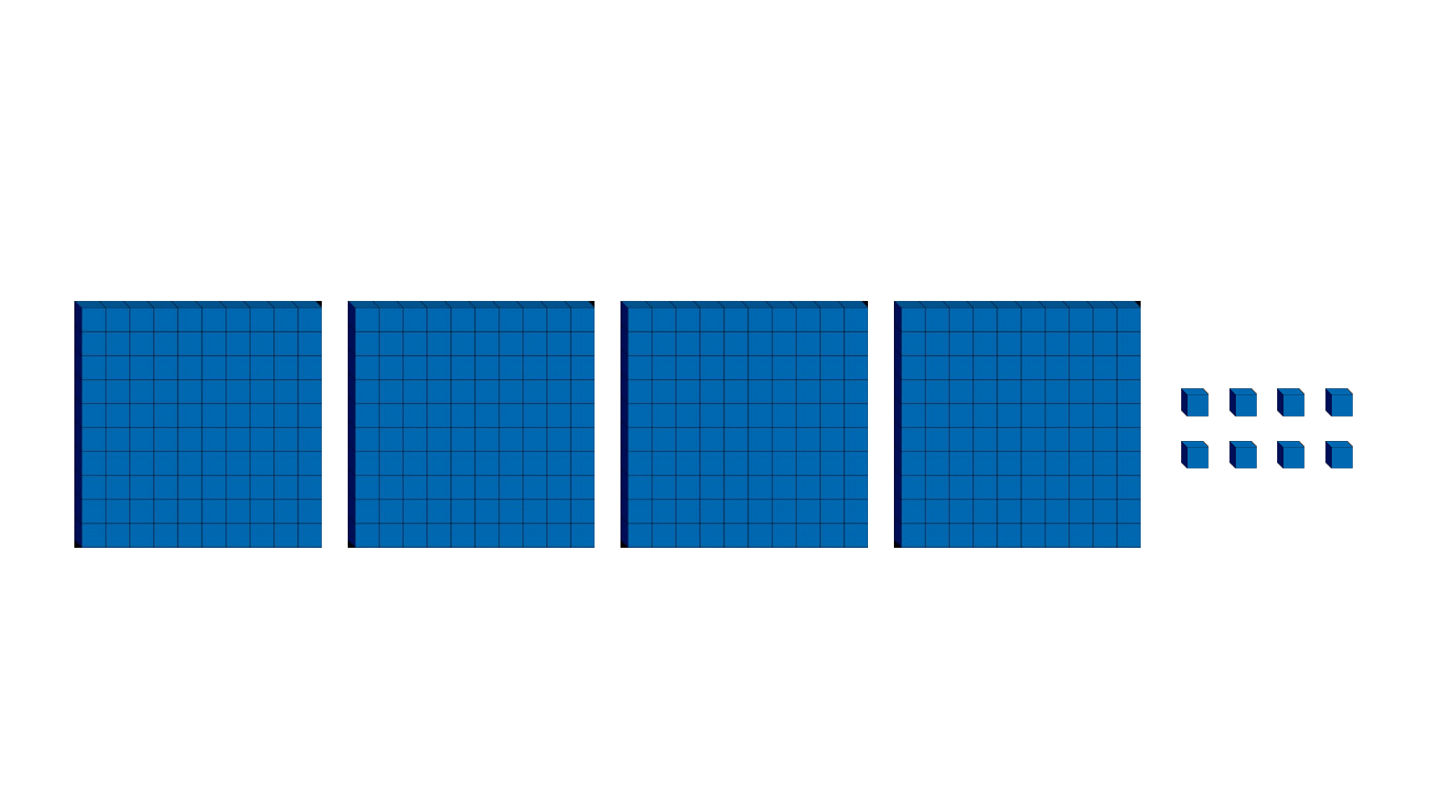
Represent Numbers to 1,000
In this representation there are no tens, and this means that zero will need to be used as a place holder.
Follow up question
What number is shown by the Base 10?

Slide 13
Represent Numbers to 1,000
408. There are zero tens, and we must represent it with ‘0’ otherwise we would be writing 48.

Slide 14
Represent Numbers to 1,000
What number is represented by the place value counters below?
100
100
100
100
10
100
100
100

Slide 15
Represent Numbers to 1,000
710
100
100
100
100
10
100
100
100

Slide 16
Represent Numbers to 1,000
Represent the number five hundred and thirty-one using Base 10.

Slide 17
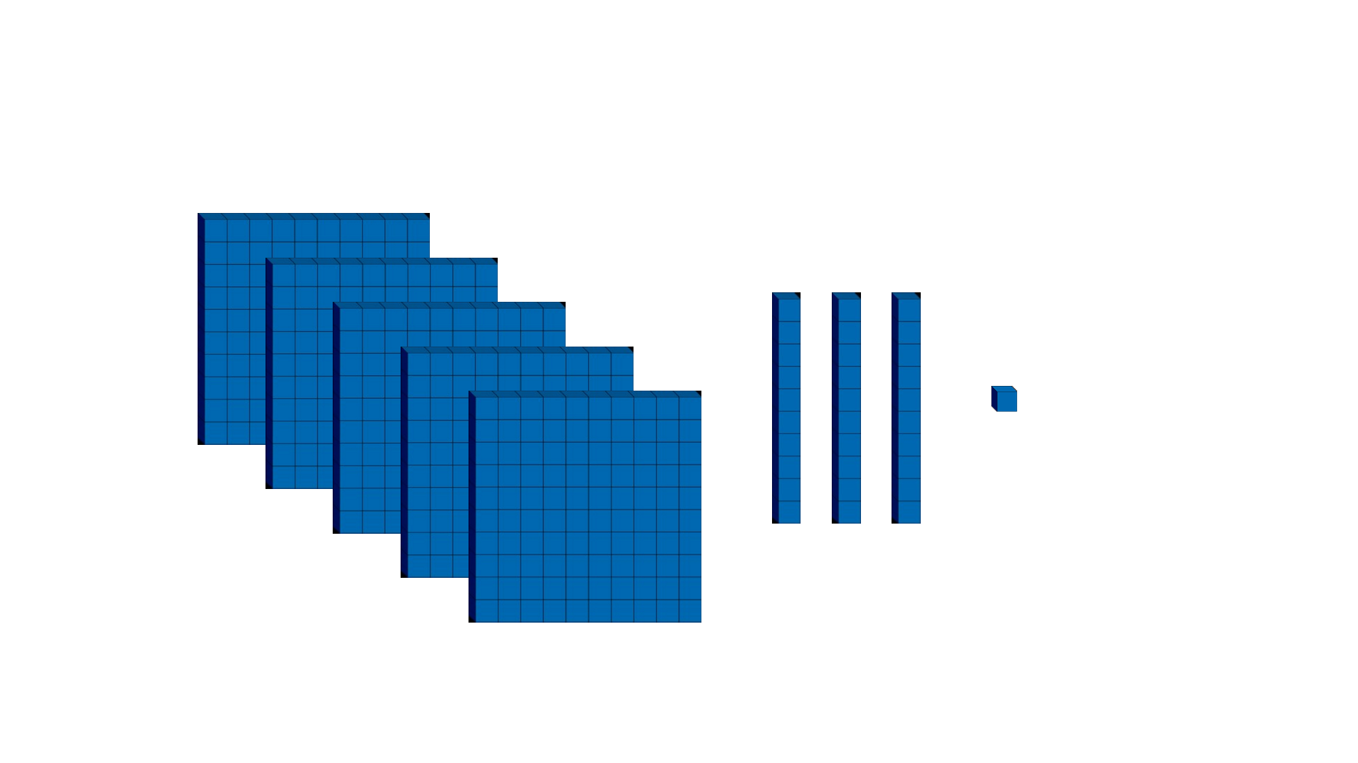
Represent Numbers to 1,000
Represent the number five hundred and thirty-one using Base 10.

Slide 18
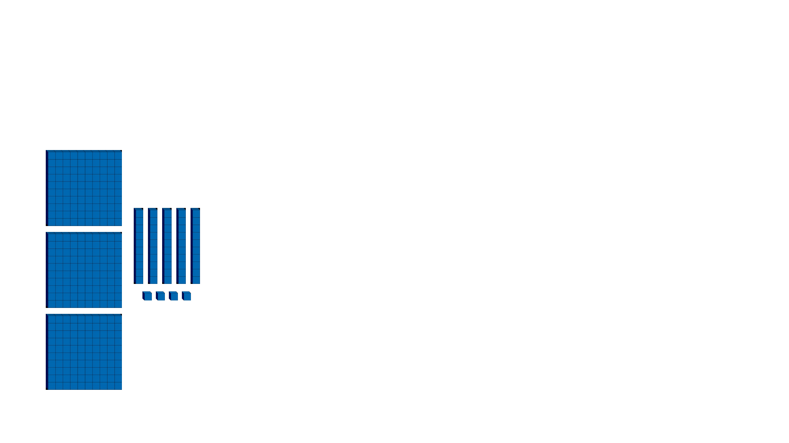
Represent Numbers to 1,000
Circle the representation that shows 345.
100
100
100
100
100
100
10
10
10
10
10
10
10
10
1
10
1
1
1
1
1
1
1
1
1
1
1

Slide 19
Represent Numbers to 1,000
Circle the representation that shows 345.
100
100
100
100
100
100
10
10
10
10
10
10
10
10
1
10
1
1
1
1
1
1
1
1
1
1
1

Slide 20
Represent Numbers to 1,000
Now that we can represent numbers to 1,000, let’s apply our learning to some problem solving and reasoning questions.

Slide 21
Represent Numbers to 1,000
Lucas wants to represent 706. He wants to represent it using counters. He says,
I need 7 hundreds counters, 10 tens counters and 6 ones counters.
Is he correct? Explain why.

Slide 22
Represent Numbers to 1,000
Lucas wants to represent 706. He wants to represent it using counters. He says,
I need 7 hundreds counters, 10 tens counters and 6 ones counters.
Is he correct? Explain why.
Lucas is incorrect because…

Slide 23
Represent Numbers to 1,000
Lucas wants to represent 706. He wants to represent it using counters. He says,
I need 7 hundreds counters, 10 tens counters and 6 ones counters.
Is he correct? Explain why.
Lucas is incorrect because he only needs 7 hundreds and 6 ones counters.

Slide 24
Represent Numbers to 1,000
Investigate three different 3-digit numbers that can be represented with no more than 8 hundreds counters, 1 tens counter and fewer than 7 ones counters. You can use all or some of the counters.

Slide 25
Represent Numbers to 1,000
Investigate three different 3-digit numbers that can be represented with no more than 8 hundreds counters, 1 tens counter and fewer than 7 ones counters. You can use all or some of the counters.
100
100
100
100
100
10
100
100
100
100
100
100
1
1
1
100
100
100
1
1
1
100
10
1
Various answers, for example: 601; 215; 711

