Slide 2
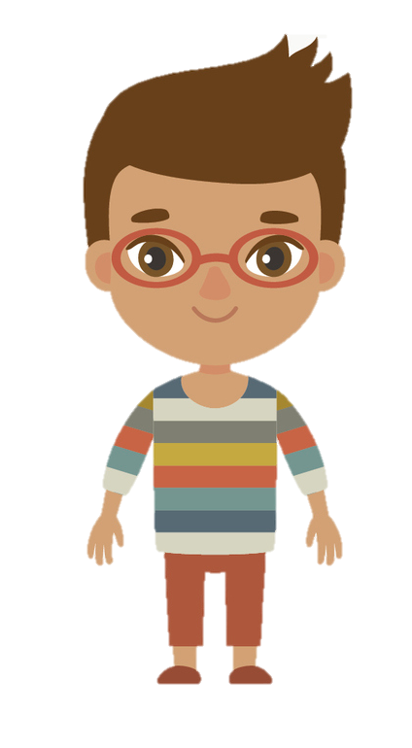
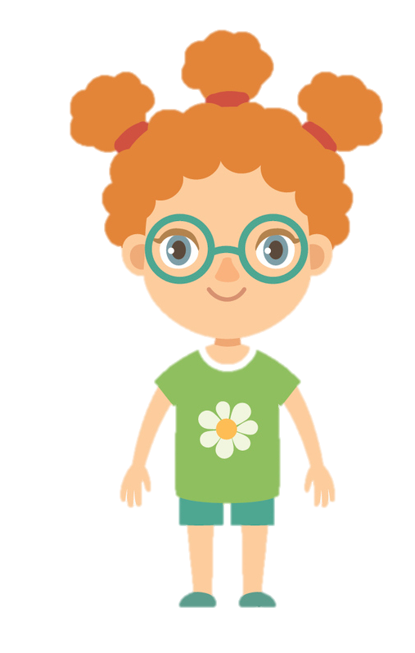
Measure Capacity
1. Match the container to the capacity and write it in the box below.
2. Each friend gets 250ml of juice. Use the empty container and draw a line to show how much juice would be left after everyone has had a drink.
3. Dr Stien is using ingredients from the list below to make a potion. His potion includes 4 ingredients and is not more than 2L when it’s made. What could the ingredients for his potion be? Write down 3 possibilities.
ml
2L
1L 800ml
1L 600ml
1L 400ml
1L 200ml
1L
800ml
600ml
400ml
200ml
0
ml
2L
1L 800ml
1L 600ml
1L 400ml
1L 200ml
1L
800ml
600ml
400ml
200ml
0
ml
2L
1L 800ml
1L 600ml
1L 400ml
1L 200ml
1L
800ml
600ml
400ml
200ml
0
ml
2L
1L 800ml
1L 600ml
1L 400ml
1L 200ml
1L
800ml
600ml
400ml
200ml
0
1. | 2.
3. | 4.
1L and 400ml
1L and 600ml
1L and 900ml
1L and 300ml
A. | B. | C. | D.
ml
2L
1L 800ml
1L 600ml
1L 400ml
1L 200ml
1L
800ml
600ml
400ml
200ml
0
ml
2L
1L 800ml
1L 600ml
1L 400ml
1L 200ml
1L
800ml
600ml
400ml
200ml
0
ml
2L
1L 800ml
1L 600ml
1L 400ml
1L 200ml
1L
800ml
600ml
400ml
200ml
0
ml
2L
1L 800ml
1L 600ml
1L 400ml
1L 200ml
1L
800ml
600ml
400ml
200ml
0
Ingredient | Volume
Iodine | 100ml
Ascorbic Acid | 200ml
Glycerine | 1L and 0ml
Sulphate | 0L and 600ml
Nitrate | 500ml
Sugar Solution | 1L and 200ml
Fructose Syrup | 300ml
This worksheet is part of our Year 3 Home Learning Pack for Week 11.
Visit kids.classroomsecrets.co.uk for online games to support learning.
© Classroom Secrets Limited 2020

