Slide 1
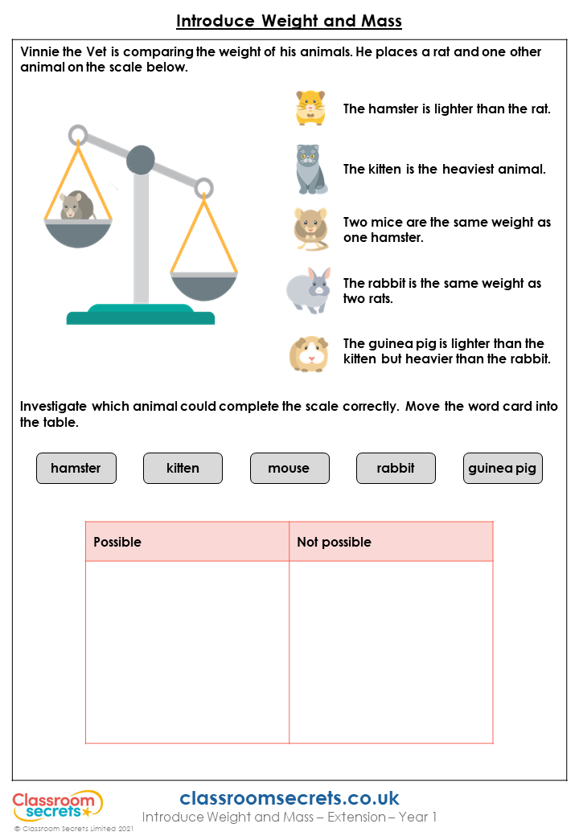
hamster
kitten
mouse
rabbit
guinea pig

