Slide 1
© Classroom Secrets Limited 2019

Slide 2
Christmas Inference Morning Starter Activity
About This Resource:
This resource is designed to develop inference skills and allow children to think about working cooperatively. You can complete the task as a whole class, in groups or individually depending on the needs of your class.
Development Matters Statements:
ELG for Communication and Language: Children listen attentively in a range of situations. They listen to stories, accurately anticipating key events and respond to what they hear with relevant comments, questions or actions. They give their attention to what others say and respond appropriately, while engaged in another activity.
National Curriculum Objectives:
Reading: English Year 1 and Year 2: Understand both the books they can already read accurately and fluently and those they listen to by making inferences on the basis of what is being said and done
Reading: English Year 3 and Year 4: Understand what they read, in books they can read independently, by drawing inferences such as inferring characters’ feelings, thoughts and motives from their actions, and justifying inferences with evidence.
Reading: English Year 5 and Year 6: Understand what they read by drawing inferences such as inferring characters’ feelings, thoughts and motives from their actions, and justifying inferences with evidence.
More Christmas resources.
© Classroom Secrets Limited 2019

Slide 3
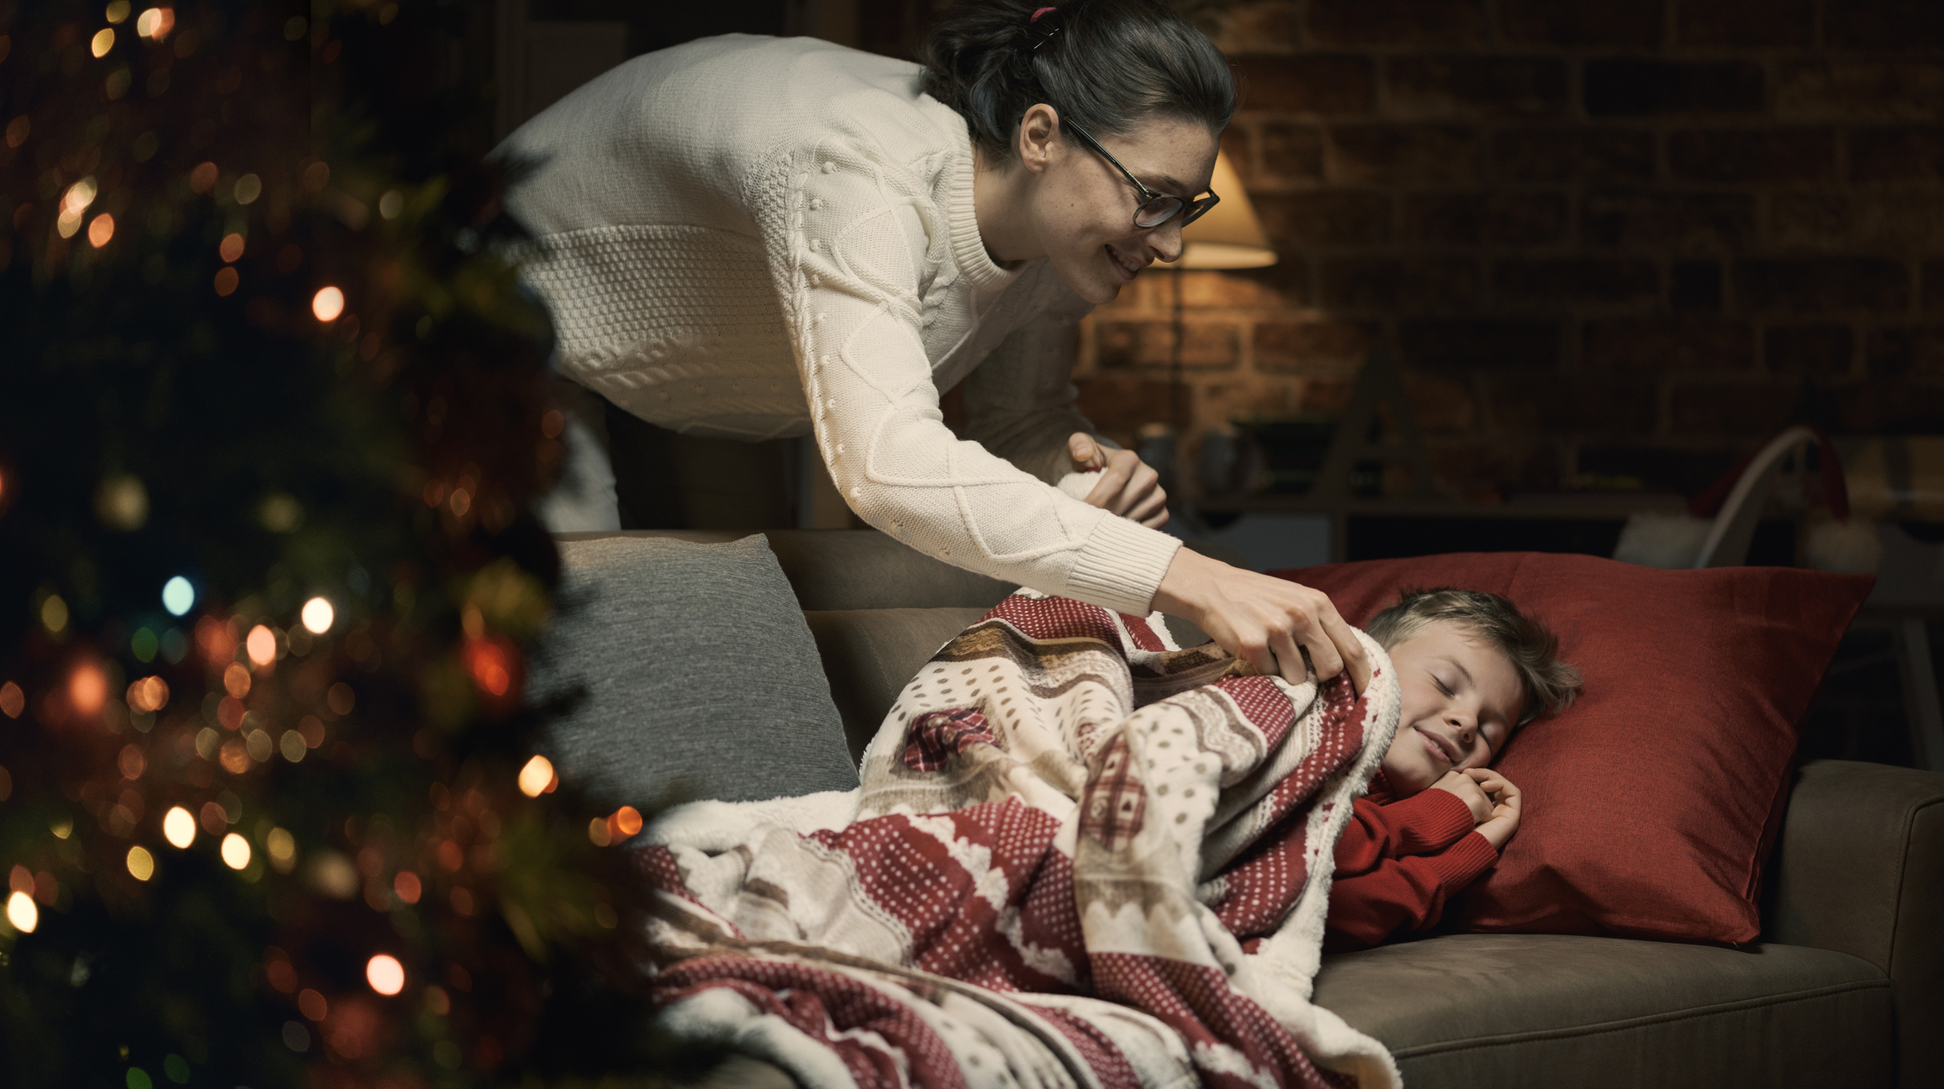
Look at the image below.
EYFS
© Classroom Secrets Limited 2019

Slide 4
1. What can you see in the photo?
2. What time of day do you think it is? Why?
3. Why is the boy smiling?
4. Why do you think the boy isn’t in his bed?
5. How do you think his mum is feeling?
6. What might happen next?
EYFS
© Classroom Secrets Limited 2019

Slide 5
1. What can you see in the photo?
Various answers, for example:
A lady putting a child to bed. A boy having a sleep on the sofa.
2. What time of day do you think it is? Why?
Evening, night time. The room is dark. There’s a lamp on in the background.
3. Why is the boy smiling?
Maybe he’s had a great day out with his family. Maybe it’s Christmas Eve and he’s excited.
4. Why do you think the boy isn’t in his bed?
Maybe his bed is broken! Maybe he’s waiting for Santa.
5. How do you think his mum is feeling?
Various answers, for example:
She’s feeling proud because he’s going to sleep. She’s happy because she loves him.
6. What might happen next?
Various answers, for example:
Santa comes and brings some presents! The boy wakes up when Santa comes.
EYFS
© Classroom Secrets Limited 2019

Slide 6
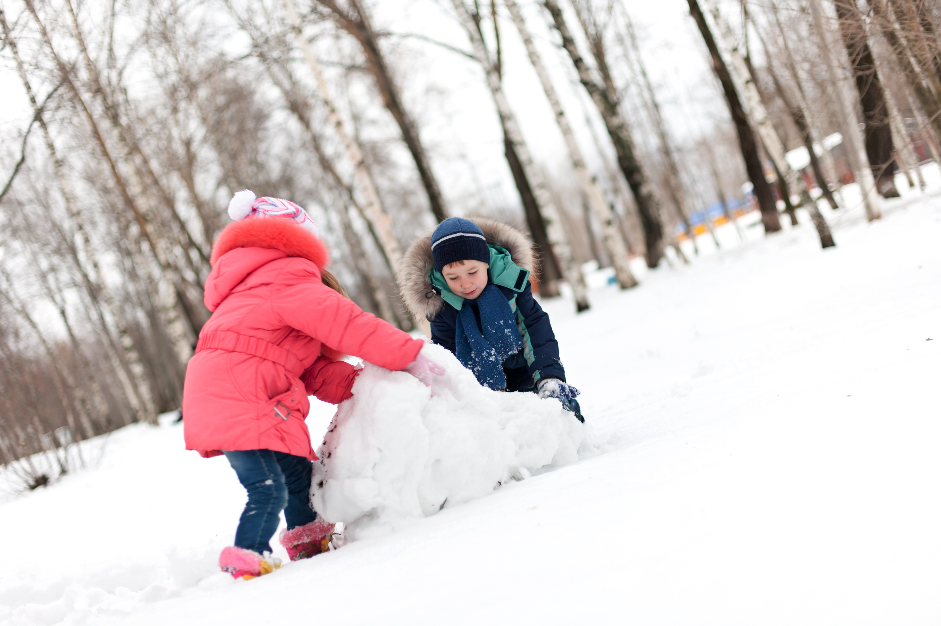
Look at the image below.
KS1
© Classroom Secrets Limited 2019

Slide 7
1. What can you see in the photo?
2. Why are they wearing hats and gloves?
3. What do you think they are making?
4. Where do you think they are?
5. What words would you use to describe the photo?
6. What other things will they need to collect and why?
KS1
© Classroom Secrets Limited 2019

Slide 8
1. What can you see in the photo?
Two children playing outside in the snow.
2. Why are they wearing hats and gloves?
The snow is cold.
3. What do you think they are making?
A snowman.
4. Where do you think they are?
Various answers, for example: In a park.
5. What words would you use to describe the photo?
Various answers, for example:
Happy, cold, friends.
6. What other things will they need to collect and why?
Various answers, for example:
Stones for eyes and mouth.
Twigs for arms.
KS1
© Classroom Secrets Limited 2019

Slide 9
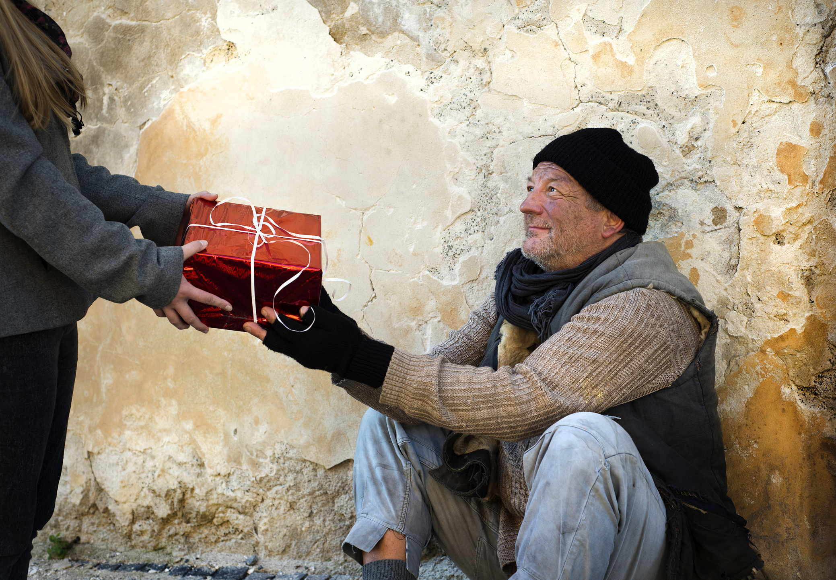
Look at the image below.
LKS2
© Classroom Secrets Limited 2019

Slide 10
1. What can you see in the photo?
2. What words would you use to describe the man in the photo?
3. What time of year is it?
4. What is the person standing up doing?
5. What two questions would you like to ask about the photo?
6. What title would you give the photo?
LKS2
© Classroom Secrets Limited 2019

Slide 11
1. What can you see in the photo?
A man sat on the street, a present, a person.
2. What words would you use to describe the man in the photo?
Various answers, for example:
Poor, homeless, dirty.
3. What time of year is it?
Autumn or winter because the man has a hat and gloves on.
4. What is the person standing up doing?
Giving the man a gift.
5. What two questions would you like to ask about the photo?
Various answers, for example:
Who is the man?
Why is he sat on the street?
6. What title would you give the photo?
Various answers, for example:
Give to the Poor at Christmas.
LKS2
© Classroom Secrets Limited 2019

Slide 12
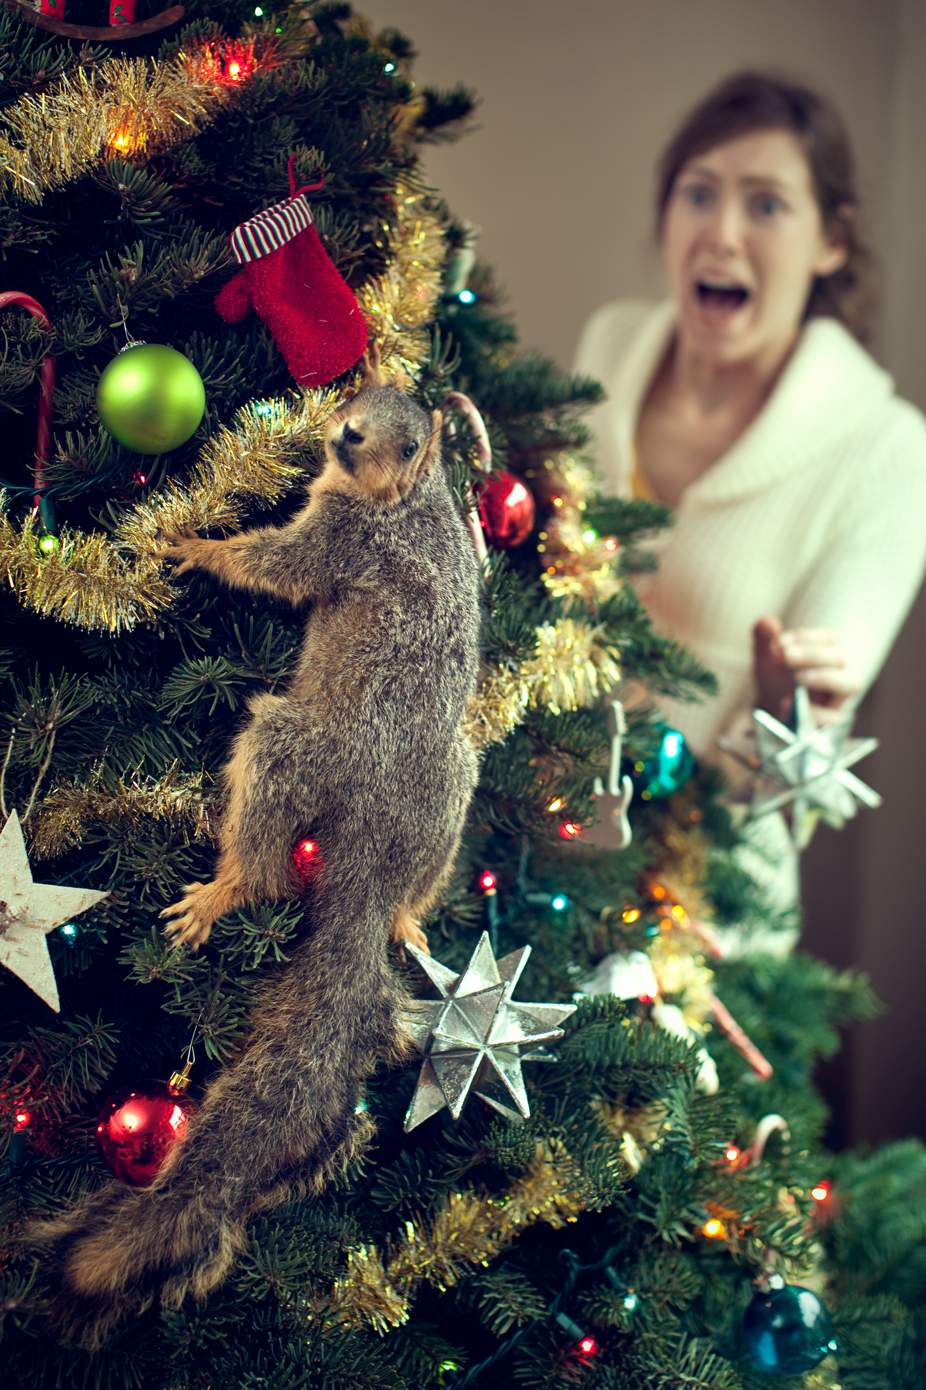
Look at the image below.
UKS2
© Classroom Secrets Limited 2019

Slide 13
4. Whose home has been invaded? Give two different answers and explain why.
1. What is happening in this image?
2. Where do you think the squirrel came from?
3. How do you think the squirrel is feeling? Why?
5. What two questions would you like to ask about this image?
UKS2
© Classroom Secrets Limited 2019

Slide 14
4. Whose home has been invaded? Give two different answers and explain why.
Various answers, for example: The woman because she has a wild animal inside her home.
The squirrel because his home has been destroyed and removed when the tree was cut down.
1. What is happening in this image?
A woman is stunned to discover a squirrel climbing up her Christmas tree.
2. Where do you think the squirrel came from?
Various answers, for example: The squirrel may have been living within the tree when it was cut down.
3. How do you think the squirrel is feeling? Why?
Various answers, for example: Shocked and disorientated because it is in an unknown environment.
5. What two questions would you like to ask about this image?
Various answers, for example: What will happen to the squirrel?
Is there more than one wild animal in the tree?
UKS2
© Classroom Secrets Limited 2019

